Slide 1



PRESENTS
AN EVENT ON SELF-DEFENSE,
SAFETY & MESSAGES OF HOPE

Slide 2

We’re so glad you’re here.
STONGER WOMEN.
BRIGHTER FUTURES.

Slide 3



THE PROGRAM WILL BEGIN SOON.

Slide 4



Supporting women and families in our community through meaningful giving and partnerships.
Scan the QR code to support
Ellafi Kind and help make
a difference in our community.
YOUNG
GIRLS
HOUSING
DOMESTIC VIOLENCE SUPPORT

Slide 5



Look for our
Conversation
Cards
You may notice these cards throughout the area. They're a fun way to get to know someone new and start a meaningful conversation.

Slide 6



Leave a
Visit our Messages of Hope area to write
a message of encouragement, strength,
or support and add it to our wall.
WRITE IT. SHARE IT. SPREAD HOPE.

Slide 7









TO OUR PARTNERS

Slide 8

Today’s Agenda
Welcome & Opening – Robyn Swanson
Mental Wellness, Hope & Resilience – Mimi Gonzalez
Domestic Violence Prevention & Support – Kasey Harding
Money, Mental Wellness & You – LaQueshia Clemons
Top 10 Personal & Home Safety Tips – Sgt. Jimmy Lacasse
Short Break
Self-Defense Experience – Kayla Stomberg
Strength in Action: Bringing It Together – Mimi Gonzalez
Ellafi Kind: From Awareness to Action – Robyn Swanson
Connect, Reflect & Celebrate

Slide 9

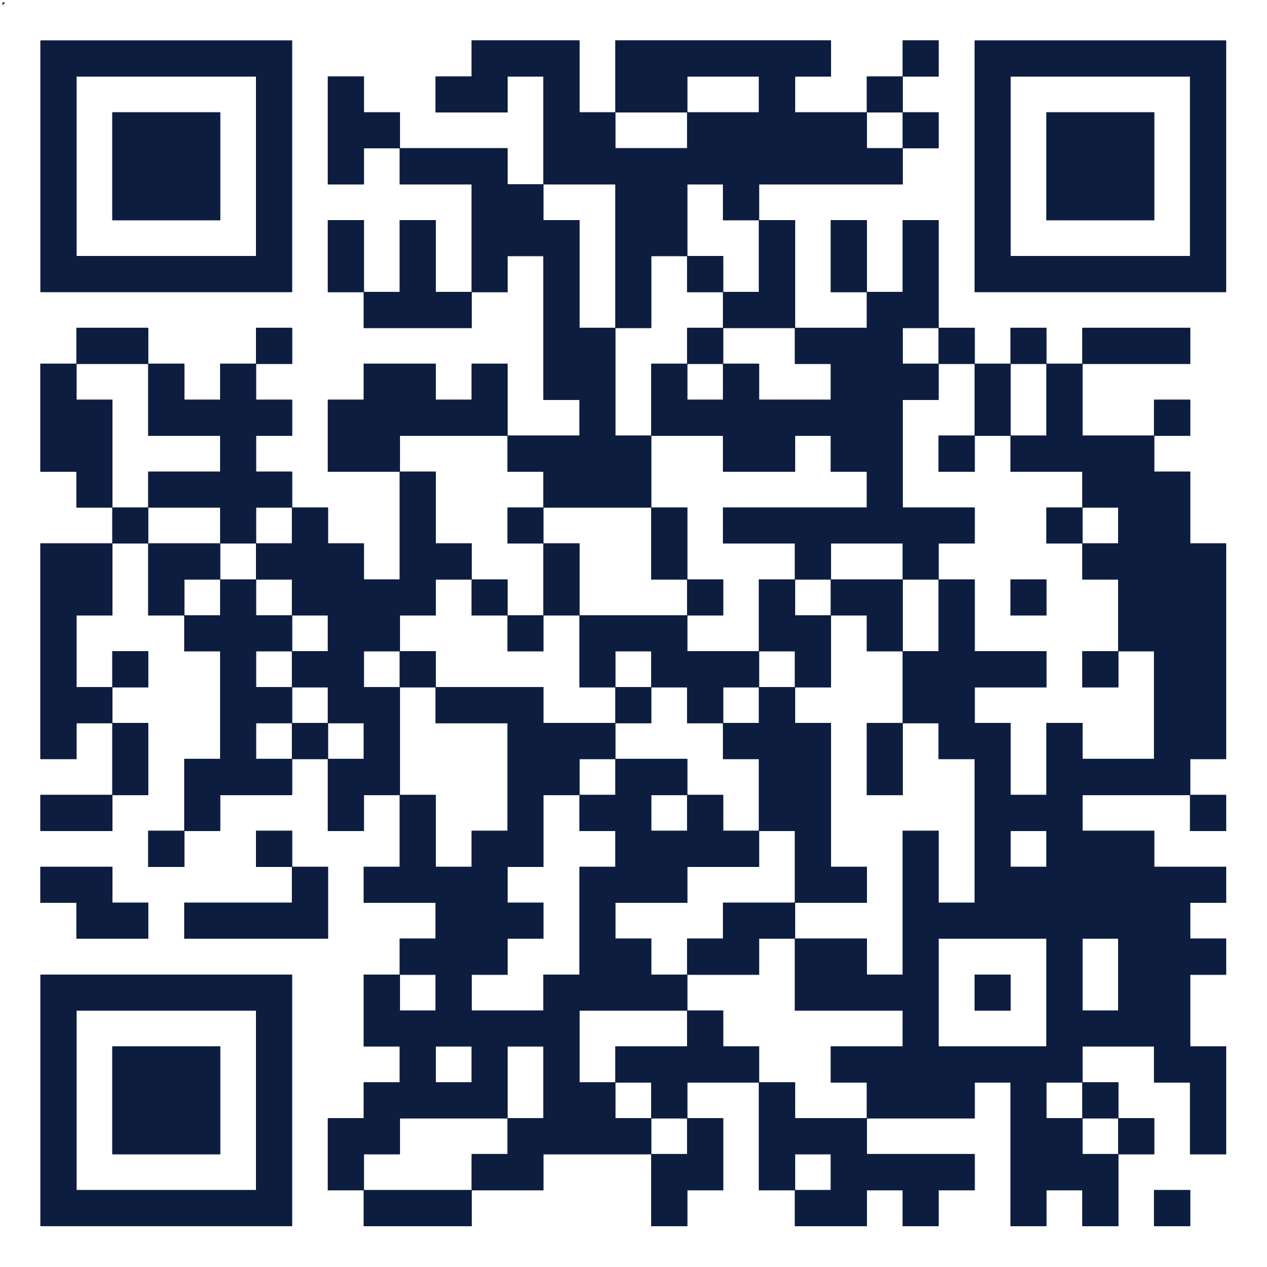

Explore Resources
Scan the QR code to learn more about today’s event and explore local and statewide organizations offering support, assistance, counseling, and financial resources.

Slide 10
Supporting women and families in our community through meaningful giving and partnerships.
Scan the QR code to support
Ellafi Kind and help make
a difference in our community.
YOUNG
GIRLS
HOUSING
DOMESTIC VIOLENCE SUPPORT

