Slide 1
PRESENTS
AN EVENT ON SELF-DEFENSE,
SAFETY & MESSAGES OF HOPE

Slide 2
Robyn Swanson
President/CEO of Ellafi Federal Credit Union
Robyn leads Ellafi Federal Credit Union with a commitment to financial empowerment, community engagement, and helping women+ and their allies achieve financial independence. She is passionate about creating opportunities for individuals and families to build stronger financial futures.

Slide 3
Mimi Gonzalez
Founder, Creator House
Mimi is an entrepreneur, creator, and mental wellness advocate. An Obama Foundation Community Leadership Corps Fellow and former Fortune 500 executive at age 24, she brings a unique perspective on resilience, leadership, and personal growth. Through her work, Mimi inspires meaningful conversations about mental wellness, hope, and empowerment.

Slide 4
Kasey Harding
Director, Center for Key Populations & New Horizons Domestic Violence Services
Kasey is a public health leader dedicated to supporting vulnerable populations and survivors of domestic violence. Through her work, she advocates for prevention, education, accessible resources, and community partnerships that help individuals and families find safety and support.

Slide 5
Understanding the Dynamics of VIOLENCE
Domestic Violence
Intimate Partner Violence
Family Violence
BREAK THE SILENCE
END THE VIOLENCE

Slide 6


Podcasts
Narcissist Apocalypse
Something was Wrong
True Crime: DV
What’s Love Got To Do With It?
The Burning Bed
Sleeping with the Enemy
MOVIES
Maid
Telling Amy’s Story
Not Without my Daughter
Dangerous Intentions
Streaming
TV
No Visible Bruises: What We Don’t Know About DV Could Kill Us
Rachel Louise Snyder
Assume Nothing; A Memoir of Intimate Violence
Tonya Salvaratnam
Black and Blue
Anna Quinlen
BOOKS

Slide 7

What is Domestic Violence?
Domestic violence is a pattern of behavior within an intimate relationship where one individual tries to control and dominate the other.
The behavior may be coercive in nature or involve physical or sexual abuse with the victim oftentimes left feeling scared, confused, dependent and insecure. Domestic Violence, in whatever form it occurs, causes trauma for the individual who experiences it.
Assaulting, threatening, harassing, strangling, or stalking an intimate partner is a crime in the State of Connecticut and punishable with jail time.
Notes:
TRAINER NOTES
IPV and DV used interchangeably- The difference would be if you said Family Violence.
We highlight pattern and control because this is not a random person that walked down the street and punched you, this is a built relationship
Not all instances of IPV rise to the level of a crime. No matter what form of abuse someone might be enduring, they can reach out to a 24/7 IPV advocate
Because someone hasn’t been hit, doesn’t mean they can’t seek resources

Slide 8
What is Intimate Partner Violence
Intimate Partner Violence is (IPV) is a pattern of coercive behaviors used by a current or former partner to establish power and control, and can encompass physical, sexual, emotional, economic, and psychological abuse, including stalking. It affects individuals regardless of age, gender, or background. IPV often involves fear, intimidation, and manipulation.
An intimate partner is a person with whom one has a close personal relationship that can be characterized by the following:
•Emotional connectedness
•Regular contact
•Ongoing physical contact and sexual behavior
•Identity as a couple
•Familiarity and knowledge about each other’s lives

Slide 9
Connecticut Statewide Domestic Violence Service
CTSafeConnect is run by The CT Coalition Against Domestic Violence (CCADV) and will provide counseling while directing individuals to the appropriate member agency for services like shelter.
Notes:
The pandemic has both increased COMPLEXITY OF VICTIM NEEDS and created additional BARRIERS TO ACCESS SERVICES. Our member organizations have stretched continuously dwindling resources to meet the increased complexity of needs. The pandemic has also severely impacted our EFFORTS TO REACH MORE UNDERSERVED COMMUNITIES.
the pandemic has resulted in skyrocketing shelter needs while simultaneously limiting space available in shelter due to public health and spacing guidelines. This meant using hotels to shelter individuals which drastically increased costs for
Victims have experienced increased complexity in needs throughout the pandemic, resulting in more contacts, multiple referrals, and more intensive case management. our members.

Slide 10
Connecticut Statewide Domestic Violence Service Statistics
Notes:
The pandemic has both increased COMPLEXITY OF VICTIM NEEDS and created additional BARRIERS TO ACCESS SERVICES. Our member organizations have stretched continuously dwindling resources to meet the increased complexity of needs. The pandemic has also severely impacted our EFFORTS TO REACH MORE UNDERSERVED COMMUNITIES.
the pandemic has resulted in skyrocketing shelter needs while simultaneously limiting space available in shelter due to public health and spacing guidelines. This meant using hotels to shelter individuals which drastically increased costs for
Victims have experienced increased complexity in needs throughout the pandemic, resulting in more contacts, multiple referrals, and more intensive case management. our members.

Slide 11
National Domestic Violence Service Statistics
Intimate partner violence alone affects more than 12 million people in the US every year.
Over 1 in 3 women (35.6%) and 1 in 4 men (28.5%) in the US have experienced rape, physical violence, and/or stalking by an intimate partner in their lifetime.
Women ages 18 to 24 and 25 to 34 generally experience the highest rates of intimate partner violence.
40% of victims of child abuse victims also reported experiencing DV in their homes and DV was the single leading predictor of lethal child abuse.
43% of dating college women reported experiencing abusive dating behavior and Violence.
Children exposed to violence in their homes are 15 times more likely to be the victim of domestic violence themselves.
Female intimate partner victims are more likely to be killed with a firearm than by all other means combined.
The presence of a gun in DV situations increases the risk of death by over 500%.
DV victims are 6 times more likely to develop a substance use issue.

Slide 12
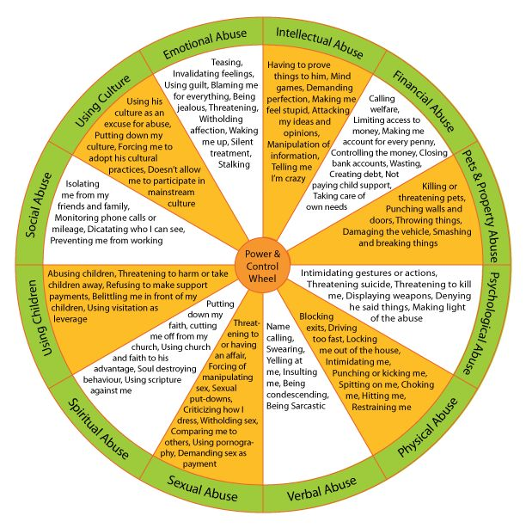
Power and Control Wheels

Slide 13






Common Methods of Control
EMOTIONAL OR PSYCHOLOGICAL: threating, intimidation, humiliation, extreme jealousy/possessiveness, threating acts of violence, criticizing, insulting, belittling, ignoring, dismissing, blaming, invading privacy.
PHYSICAL: hitting, pushing, shoving, slapping, punching, holding, restraining, choking, strangling, inflicting bruises or welts, physically dragging,
pulling hair, biting.
SEXUAL: coercing victim to have sex, watch pornography, sexually transmitted infections, using date rape drugs
TECHNOLOGICAL: tracking location, demanding check-ins, excessive
texting, spyware, monitoring communications, posting on social media.
FINANCIAL: withholding money, no access to bank accounts/ATM
and credit cards, ruining a victim’s credit, taking the victim’s paycheck.
Notes:
TRAINER: Quick explanation of the fact that IPV is not one size fits all.
Many times health professionals will not see abuse, but will see the emotional and psychological affect of walking on eggshells/living in fight or flight.
There are many times several questions within the IPV screening because IPV has so many different methods of control
Important for providers to understand that.

Slide 14
Challenges to Leaving
Abuser
Children
Pets
Victim
Survivor
Job
Property
Money
Fear​ of being hurt or killed
Humiliation for being in the situation
Love​ for the abuser and their family
  Individuals return to abusive relationships 5-7 times, on average.
Children​ danger in taking them and danger in leaving them
Money ​that is not accessible without abuser
Limited or no support system​
Abuser promises to change​​
It might be safer to stay at that time
Substance Use or Mental Health Barriers
Gaslighting “You’re crazy – I do not hurt/control you.”
Trauma
  Effects the way victims approach potentially helpful relationships, compounding issues of isolation.
​

Slide 15
The Economic Impact of
Intimate Partner Violence
Victims experience 4 times higher rate of job instability.
Victims experience 3 times higher rate of medical out of pocket expense.
Victims experience 89% less opportunity for education attainment.
Victims experience 95% higher costs related to lost housing, eviction or relocation.
Victims experience 20X higher cost related to legal fees and immigration fees than their peers.
Victims are responsible for credit card debt that is 5-10 times higher than their peers due to financial coercion or fraud.
Victims experience 150% higher rate of days lost at work than peers.
Victims experience 500% less lifetime earning than their peers.
Victims experience 200% higher rate of job loss due to absence, relocation, or illness.
Victims experience asset depletion that is 25x more likely to affect long term financial status.
Victims have a financial literacy level that is on average at the level of a 4th grader in the US.

Slide 16
Domestic Violence and Health
Higher rates of Chronic Illnesses (3X)
Higher rates of Emergency Room Visits (6X)
Higher rates of Hospital Admissions
Reduced rates of Health Screenings
Higher rates of unplanned pregnancies (3X)
Higher rate of HIV and STI’s (2X)
Higher rate of diagnosed PTSD (2X)
Higher rate of Suicide (2X)
Higher rate of low birth weight babies (3X)
Abuse is more common for woman in the United States than breast cancer and diabetes combined.
The costs of intimate partner violence exceed $8.3 billion annually.
$4.1 billion of which
is for direct medical and
mental health care services.
​
Notes:
INFO FROM: https://www.futureswithoutviolence.org/wp-content/uploads/May-25-2017-CUES-IPVhealth-webinar.pdf
1. Healthcare utilization and costs for women with a history of intimate partner violence.
Rivara FP¹, Anderson ML, Fishman P, Bonomi AE, Reid RJ, Carrell D, Thompson RS.
Author information 1Harborview Injury Prevention and Research Center and the Department of Pediatrics, University of Washington, Seattle, Washington 98104, USA. fpr@u.washington.edu
https://www.ncbi.nlm.nih.gov/pubmed/17234483
2. Arias & Corso, 2005, Chrisler & Fergun, 2006) Chrisler & Ferguson, 2006 Abbott et al, 1995; Coker et al, 2002; Frye et al, 2001; Goldberg et al, 1984; Golding et al, 1999; McLeer et al, 1989; Stark et al, 1979; Stark & Flitcraft, 1995)
Cost: CDC https://www.cdc.gov/violenceprevention/pdf/IPVBook-a.pdf & Max, W, Rice, DP, Finkelstein, E, Bardwell, R, Leadbetter, S. 2004)
Other Statistics:
-American Society of Addiction Med : https://www.asam.org/resources/publications/magazine/read/article/2014/10/06/intimate-partner-violence-and-co-occurring-substance-abuse-addiction
http://www.pcadv.org/Resources/ipv.pdf
-Trafficking happens under the table, but its survivors come into contact with health-care workers more than you might think. One study found that nearly 88 percent of victims interacted with a health-care worker while being trafficked. https://www.washingtonpost.com/health/nonprofits-medical-profession-tackle-human-trafficking-as-a-health-care-crisis/2020/01/03/1aee81b6-2cec-11ea-bcb3-ac6482c4a92f_story.html

Slide 17
Medical Problems Caused by IPV
Chronic pain syndromes
Bruises, abrasions, lacerations, punctures, burns and bites
Fractures and broken bones or teeth
Long-term health problems and poor health status
Side-effects from strangulation, including petechiae and strokes
Injuries to the head, eyes, ears, chest and abdomen
Poorer HIV-related outcomes
Death, including feticide
Gastrointestinal conditions

Slide 18
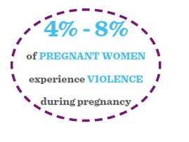
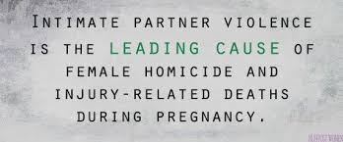
Sexual and Reproductive Health Problems Caused by IPV
Unintended/Unwanted pregnancy
Abortion/Unsafe abortion
Sexually Transmitted Infections, including HIV
Pregnancy Complications/Miscarriage
Delayed Pre-Natal Care
Chronic Pelvic Infection
Low Birthweight Babies
Infertility
Urinary Tract Infections

Slide 19
Mental Health Problems Caused by DV
Sleep disorders
Stress and anxiety disorders
Self-harm and suicide attempts
Low self-esteem
Depression
Alcohol and substance use disorders
Eating disorders

Slide 20
Mortality
DV/IPV related homicides in the US = 12,000 each year
DV/IPV accounts for more than half the murders of women in the United States every year.
For victims ages 36-44, IPV was the most common form of violence ending in death.
IPV is leading cause of death and disability for women ages 40-44.
29% of DV/IPV involves a weapon.
72% of all murder/suicides involve an intimate partner
In 94% of IPV cases that result in murder, the victim is female.

Slide 21
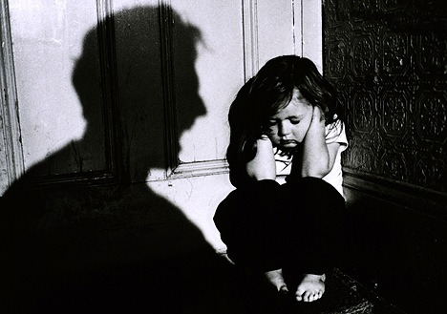
Children and Domestic Violence
1 in 15 children are exposed to violence in their homes and 94% of them are eyewitnesses to the violence.
Over 15 Million children in the US have been a witness to domestic violence at least once in their lives.
A boy who witnesses his mother experience DV is 10 times more likely to abuse a female partner as an adult.
A girl who witnesses her mother experience abuse as a child is 6X more likely to experience sexual or physical abuse as an adult than peers from non-abusive homes.
30-60% of DV Abusers also abuse the children in the home.

Slide 22

How Children Are Exposed
Violence can be passed on from one generation to the next in homes where domestic violence takes place. (The CYCLE of DV)
Children living in a home where domestic violence is occurring are:
  Learning that violence is how to deal with conflict.
  Learning that discipline includes physically or verbally attacking another member of the family.
  Hearing threats of physical harm.
  Being forced to watch or participate in violence against their mother/father or other family member.
  Having their relationship with their non-violent parent undermined.
  Experiencing the loss of a parent due to murder/suicide.
  Being parented by a caregiver who is limited by the effects of DV.

Slide 23
C
U
E
S
Confidentiality
Provide safe space that is private. Request time alone with person.
Universal Education
Provide thoughtful and concise education including hotline numbers or 211 if possible.
Postcards, flyers, tear-offs, magnets, or materials can be available if appropriate. These are cues for everyone to start a conversation.
Empower
Offer healthy relationship information and supportive language. Instill confidence.
Support
Provide support by addressing (+) and (-) responses by reiterating what is offered by resources and follow up options.

Slide 24
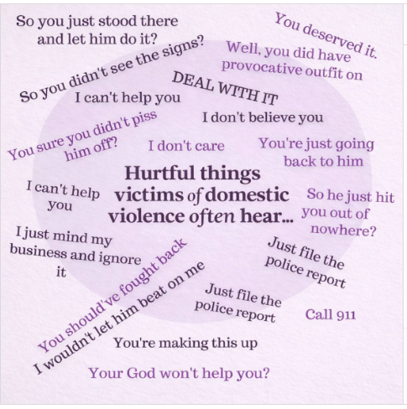
Language and Phrasing
Remember when you are talking to a potential victim that these are phrases they hear in every day life including in the media or in their personal lives. This is where they are starting from and it is your job to build trust and change the narrative.

Slide 25
Referral Information for DV
Make a referral to the statewide hotline
SafeConnect
(888) 774 – 2900

Slide 26
Make a Referral to 211
211 is a resource for childcare, soup kitchens, vocational resources so it is a safe resource to provide without fear of exposing the victim to their offender.
211 provides up to date information and contacts for all 18 DV member agencies across CT and can also provide counseling.
211 will direct victims seeking safety to the appropriate place without any barriers.

Slide 27
What Happens When You Or A Patient Calls 211
211 May I help you?
So it sounds like you need DV services. Is it safe right now to talk?
Let me get some basic information from you in case we get disconnected. What is your name…address where you are right now….phone where I can safely call you……name of your abuser if possible.
You are in Middlesex County and we have a wonderful program there called New Horizons do you think you are able to call their hotline to get help right now?
The number is 860-344-9599 and they are available 24 hours a day – 7 days a week. Do you feel comfortable if I hang up so you can make that phone call?

Slide 28
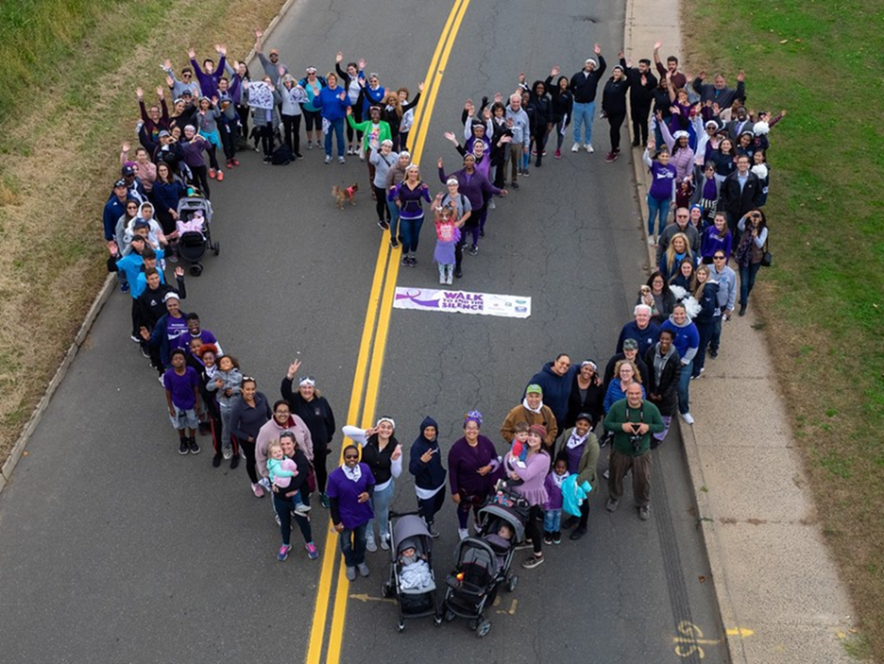
New Horizons Domestic Violence Services
We help over 1600 individuals and families who are experiencing domestic or family violence annually.
We operate a 10-12 bed emergency family shelter in Middlesex County.
We provide services to all 15 towns in Middlesex County, CT.
We are 1 of 18 members programs of the Connecticut Coalition Against Domestic Violence.
We have a staff of 15 adult/child/court advocates with specific training in domestic violence counseling and support.
We have a full time Rapid Re-Housing Advocate who works to find safe and stable housing for victims and families using funds from the state of CT
We are a program of the Community Health Center, Inc. (Moses-Weitzman Health System).
(860) 344-9599
New Horizons 24-hour Hotline

Slide 29
What IPV Services Are Available?
All 18 member programs offer the same basic services. Those services include:
24-hour Hotline Services
Individual Crisis Counseling
Safety Planning
Shelter and Safe Housing
Legal Advocacy and Court Services
Children and Family Services
Community Education and Outreach
Notes:
All IPV agencies offer a wide variety of resources, the services on the screen are offered throughout the state and including New Horizons.
Our services are dependent on the resources in our community. Our advocates do just that. They advocate for clients to get into community agencies and services as we are more of a wrap around agency making sure needs are met, not necessarily the one providing all of the resources.
24 hour hotline services:
Lap calls
Bed counts
Universal intake
Counseling intake
Donation requests
Individual crisis counseling:
PSYCHOEDUCATIONAL
General dv info
Housing
Children
Red flags
Self esteem
Future relationships
Legal assistance
Employment
Trauma
Other – up to victim
Safety planning: We will go over soon
Shelter and safe housing:
NH operates a 24-hour shelter program for individuals and families fleeing abusive relationships.
Our housing advocate works with clients to enter them into the Rapid Rehousing program.
Legal advocacy and court services:
We have two Family Violence Victim Advocates in Middletown court.
safety planning, victim input, and processing arraignments after IPV arrests.
Children and family services:
Youth and family advocate supports children both in our shelter and in the community through basic needs, outreach to schools and other partners, and developing service plans with youth clients.
We are in the process of planning and organizing 2 events for our community and shelter clients for the Holidays. Give flyers in the chat.
Warm the children…
Community education and outreach:
Schools
Health fairs
Community tabling events
Community agencies

Slide 30
Safety Planning Basics
Safety Step | Actions
Residence Exit | Practice a variety of ways to exit the home safely. Practice with children to exit safely. Plan a safe place to go or meet after exit.
Documents | Keep an envelope with important documents for individual and children along with cash hidden if possible. Include passport, birth certificate, SS card, immigration documents, insurance information, copies of lease or titles that individual’s name appears on, bank and financial information.
Communication | Alert trusted friends or neighbors about the situation in your home and ask for support if needed. Have a list of important phone numbers in case you need to leave your phone. Have all numbers on hand including 911 and 211.
Technology | Purchase a burner phone for calls that can not be tracked. Keep all technology up to date and charged. Carry cell phone with you even in the home – when you go to the bathroom etc. If possible check phone for location and other apps that may pose danger.
Environment | Hide anything that can be used as a weapon. Know where registered or unregistered weapons are. Identify safest place in home (locked basement). Avoid kitchen, garage or other places where dangerous items are stored. Avoid wearing scarves or jewelry that can be used to strangle.
Other | Identify patterns of abuse and be prepared. Make yourself a small target by curling in a corner and putting hands over your face. Teach children to never intervene when violence is happening. Never run toward children during attacks.

Slide 31
Kasey Harding hardink@chc1.com
C: (860) 301-1090
New Horizons 24-hour Hotline
(860) 344-9599 www.newhorizonsdv.com
15

Slide 32

LaQueshia Clemons
Founder & CEO | Freedom Life Therapy & Wellness
LaQueshia is a Licensed Clinical Social Worker and Accredited Financial Counselor® specializing in the connection between money and mental health. With more than a decade of experience, she helps individuals overcome financial stress, heal their relationship with money, and build emotional and financial confidence.

Slide 33



Slide 34


Slide 35






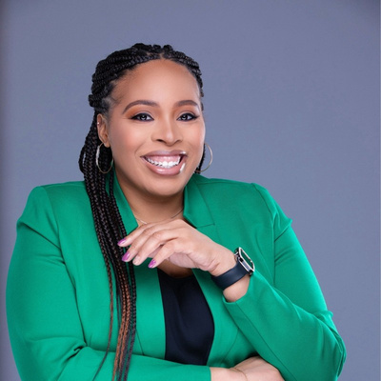
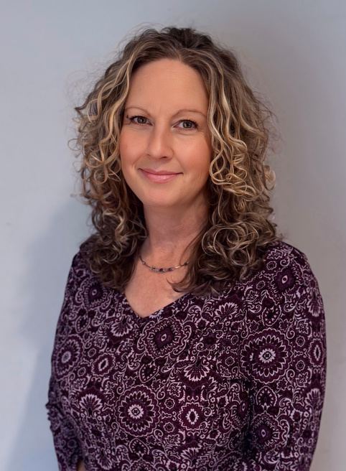

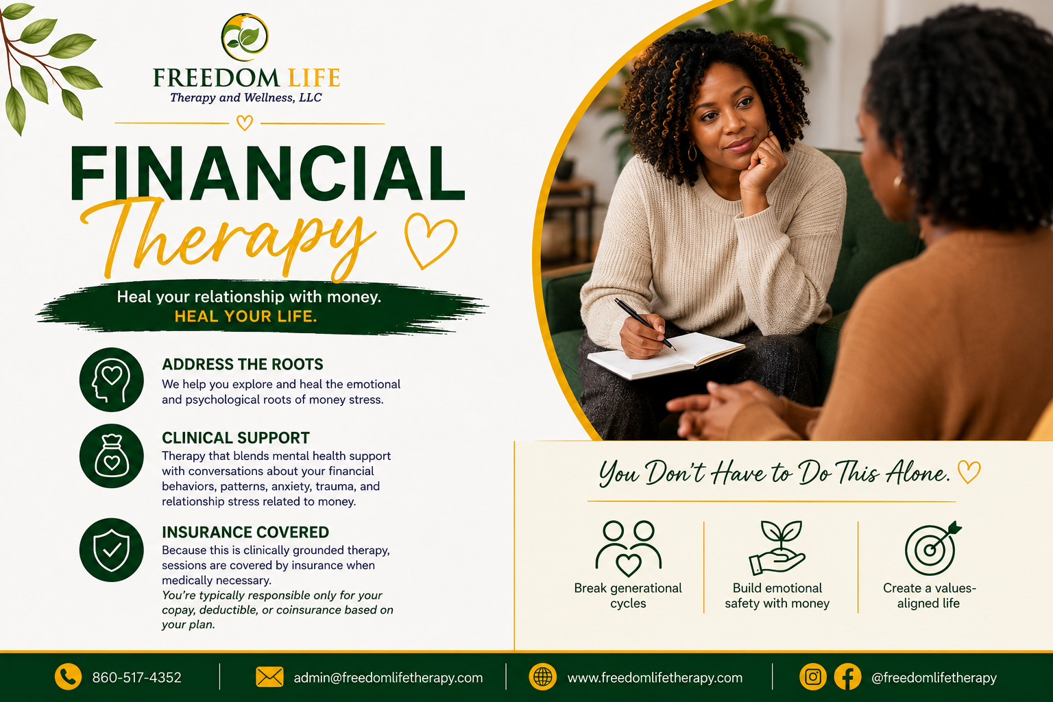

Slide 36




Slide 37




Slide 38






Slide 39





Slide 40





Slide 41




Slide 42


Slide 43

Jimmy Lacasse
Sergeant | Middletown Police Department
Personal & home safety with practical tips for staying safe, recognizing potential risks, and protecting yourself and your loved ones.

Slide 44
01
Trust your instincts
If something feels wrong, create distance first.
You can leave without giving a stranger an explanation.
Move toward a safe, populated place.
Make noise, make a scene, draw attention to the situation.
Ask: What would make you leave a situation?
STRENGTH IN ACTION
1 / 10
Notes:
Tip 1: Trust your instincts.
Describe how to notice a change in a person’s behavior or in the setting without implying that intuition is proof of a crime. Emphasize a calm exit and reaching support.
Suggested audience prompt: Ask: What would make you leave a situation?

Slide 45
02
Stay aware of your surroundings
Look up before you reach your car or door.
Pause the phone and lower the volume on earbuds.
Notice who is nearby and have your keys ready.
Have your pepper spray ready and birdie (noise maker), and car panic button.
At night or at a low populated parking lot, walk to your car with a friend or ask security or worker (gym) to escort you.
Try this: Scan the parking lot before walking out.
STRENGTH IN ACTION
2 / 10
Notes:
Tip 2: Stay aware of your surroundings.
Use an everyday parking lot or garage example. Explain that awareness means checking surroundings periodically, not staying on high alert all day.
Suggested audience prompt: Try this: Scan the parking lot before walking out.

Slide 46
03
Create distance and find an exit
Space gives you time to make a safer choice.
Distance is your friend. Step away when someone gets too close.
Head toward people, staff, security, or a well-lit area.
Always know where exits are, this will help in many safety situations: personal attacks, fires, mass shootings, robberies, natural disasters (earthquakes), etc.
Ask: Where is the nearest staffed place?
STRENGTH IN ACTION
3 / 10
Notes:
Tip 3: Create distance and find an exit.
Discuss exits in stores, event venues, and unfamiliar places. If threatened, leave and call 911 when safe.
Suggested audience prompt: Ask: Where is the nearest staffed place?

Slide 47
04
Make your home look occupied
A few routines make an empty home less obvious.
Use exterior lights and timers or smart lighting.
Share vacation photos after your return.
Beware of dog signs and alarm signs (even if you do not have a dog or alarm, studies show criminals will overwhelmingly skip houses with these signs.
Don’t let newspapers or mail stack up, have a neighbor get them.
Keep spare car in driveway not garage if you will be gone for over a few days.
Tonight: Check what is visible from outside.
STRENGTH IN ACTION
4 / 10
Notes:
Tip 4: Make your home look occupied.
Mention lighting and mail or package buildup when away. Avoid claiming any device can prevent a break-in.
Suggested audience prompt: Tonight: Check what is visible from outside.

Slide 48
05
Lock and strengthen entry points
Simple hardware habits matter every day.
Lock exterior doors and accessible windows.
Lock door from garage to house, do not rely on garage door to stop intruders.
Use simple wood poles in door sliders and windows to prevent access.
Use a quality deadbolt and a strong strike plate. * Door stoppers
Install glass break units to cover glass doors and large windows.
Have a hard room designated in the home that is extra reinforced.
Tonight: Check your doors, windows, and spare keys.
STRENGTH IN ACTION
5 / 10
Notes:
Tip 5: Lock and strengthen entry points.
Include garage-entry doors. Do not hide a spare key outside. Longer strike-plate screws may improve an appropriate door frame, but property rules and door construction vary.
Suggested audience prompt: Tonight: Check your doors, windows, and spare keys.

Slide 49
06
Verify before opening the door
A knock does not require an open door.
Use a peephole, camera, or window first. Turn all outside lights on.
Call 911, if an unexpected worker i.e.. Gas company is claiming they need access.
If you are proficient with weapons, have one with you if you are receiving unexpected knocking, especially late at night.
Solicitors could mean recon especially around voting time. (My experience)
Practice: Speak through the locked door.
STRENGTH IN ACTION
6 / 10
Notes:
Tip 6: Verify before opening the door.
A visitor claiming to be from a utility or delivery service can be verified independently. Do not use a phone number the unexpected visitor supplies as the only check.
Suggested audience prompt: Practice: Speak through the locked door.

Slide 50
07
Use layers of home security
Lighting, alerts, and strong doors work together.
Lighting, cameras, alarm signs, dog signs may discourage an approach.
Sensors alert you; locks and doors buy time.
Weapons protect you, IF you are experienced with them.
Panic/hard room buys you time IF you are not prepared to defend against intruders.
Ask: Which layer is weakest at your home?
STRENGTH IN ACTION
7 / 10
Notes:
Tip 7: Use layers of home security.
Explain deter, detect, delay in plain language. Remind the audience that cameras record and alert but do not physically stop entry. Choose improvements suitable for the home and budget.
Suggested audience prompt: Ask: Which layer is weakest at your home?

Slide 51
08
Protect your digital life
A safer home includes safer accounts.
Use unique passwords and multi-factor authentication 2FA.
Pause before opening links or sharing a code.
Yubico keys.
G-Mail vs. Yahoo.
Remote access to computer.
VPN’s
Today: Turn on multi-factor authentication.
STRENGTH IN ACTION
8 / 10
Notes:
Tip 8: Protect your digital life.
Urgent requests about money or identity can be scams. Independently contact the organization using a known website or number. Never give a one-time login code to an unexpected caller.
Suggested audience prompt: Today: Turn on multifactor authentication.

Slide 52
09
Practice a family emergency plan
Everyone should know the first move.
Plan exits and a meeting place for a fire.
Have a large-scale plan if cell phones are knocked out. i.e. 9-11.
Agree on how to get help and call 911
Rope ladders for 2nd floor bedrooms. Fire extinguisher.
This week: Practice the plan together.
STRENGTH IN ACTION
9 / 10
Notes:
Tip 9: Practice a family emergency plan.
Tailor plans for children, older adults, and people with mobility needs. A fire plan calls for evacuation; a threatening intruder may require a different safe response. Follow local emergency guidance.
Suggested audience prompt: This week: Practice the plan together.

Slide 53
10
Put people before property
Get safe first. Report the incident afterward.
Do not chase or confront someone over an item.
No amount of money is worth your life.
Call 911 from safety and share what you remember.
Throw your wallet away from you and run the other direction in a robbery.
Remember: Clothing, direction, vehicle, distinguishing features.
STRENGTH IN ACTION
10 / 10
Notes:
Tip 10: Put people before property.
Witness details can help, but do not delay escape to gather them. Reinforce that no phone, package, or purse is worth an injury.
Suggested audience prompt: Remember: Clothing, direction, vehicle, distinguishing features.

Slide 54

One action today
Choose one safety habit to practice this week.
Awareness. Preparation. Good decisions.
Thank you • Justin Hanson • Hanson Security Group
Notes:
Close by asking the audience to name one small change they will make. Invite questions. If someone discloses an immediate threat or domestic violence concern, direct them to appropriate onsite staff and emergency or specialist support privately, rather than asking them to share details in the room.

Slide 55

Please take a few minutes to grab a drink,
visit our resource booths and connect.

Slide 56
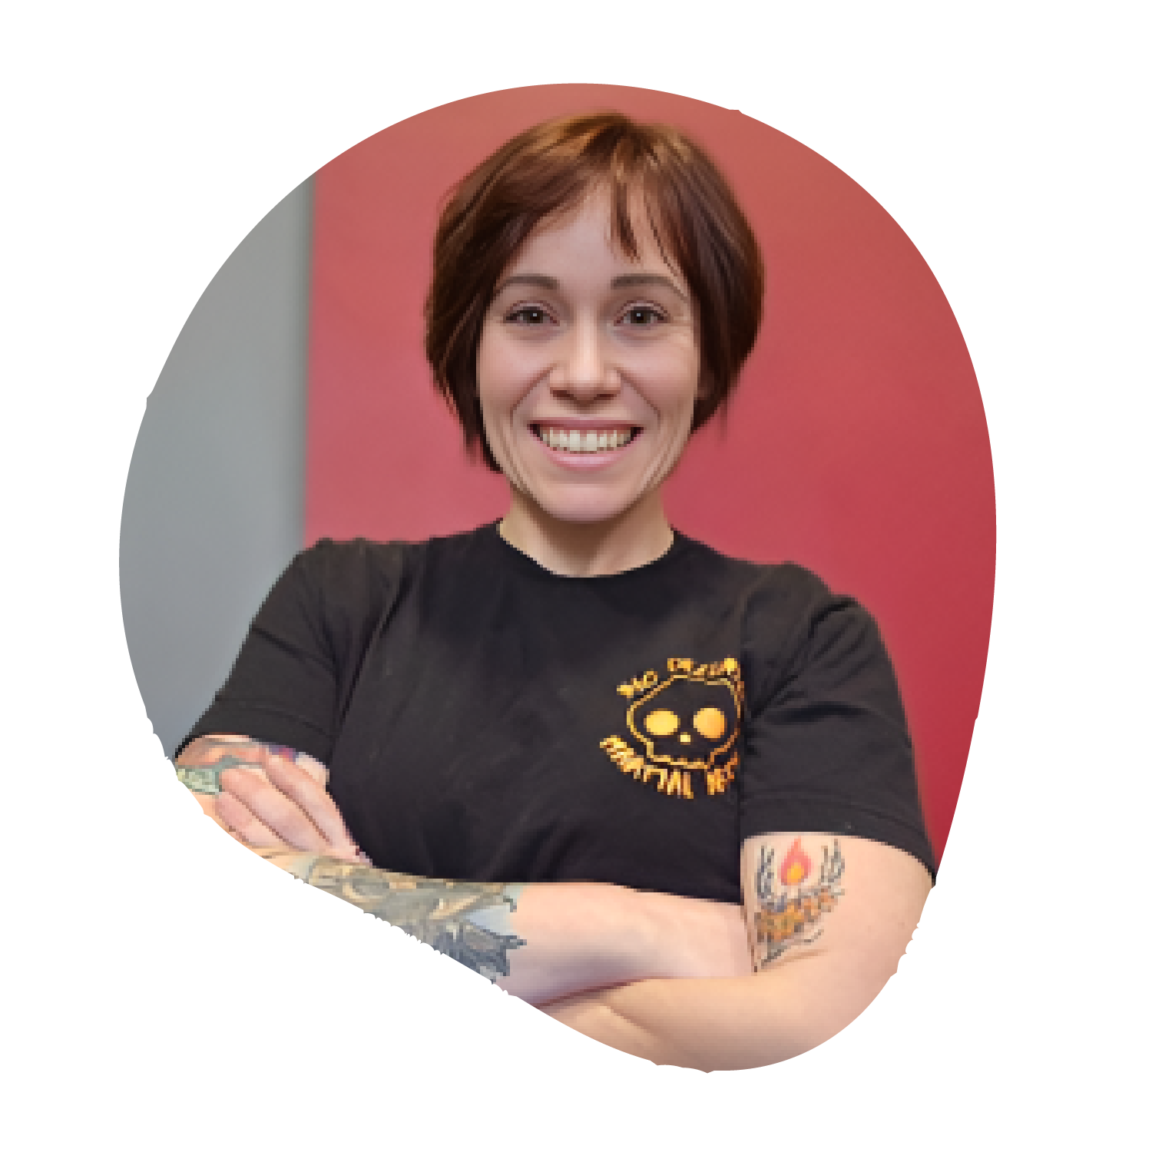
Kayla Stomberg
Owner & Head Instructor | 360 Defense Martial Arts
Kayla brings more than 18 years of martial arts and self-defense experience. A fifth-degree black belt in 360 Defense and certified ALICE Active Shooter Instructor, she specializes in practical safety education and empowering individuals with the confidence and skills to protect themselves.

Slide 57

Mimi Gonzalez
A reflection on what we've heard and how each of us
can help create a stronger circle of support.

Slide 58



Supporting women and families in our community through meaningful giving and partnerships.
Scan the QR code to support
Ellafi Kind and help make
a difference in our community.
YOUNG
GIRLS
HOUSING
DOMESTIC VIOLENCE SUPPORT

Slide 59

Support Ellafi Kind and help
make a difference in our community.
Together, we're building a stronger community through awareness, education, connection and support.

